Slide 1
SQL DATA TYPES

Slide 2
A data type is an attribute that specifies the type of data that these objects can store. It can be an integer, character string, monetary, date and time, and so on.
We are going to talk about numerics, character strings, binary strings, date & times, and other data types.

Slide 3

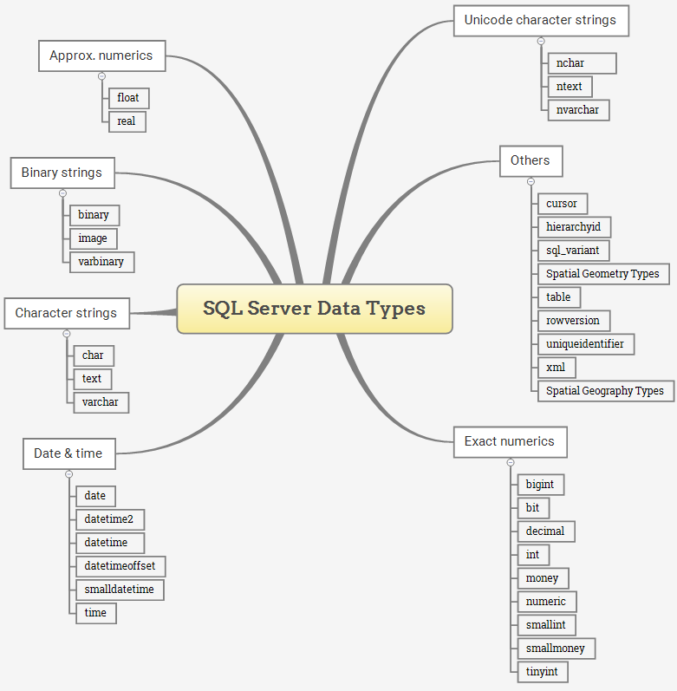





Slide 4
EXACT NUMERIC DATA TYPES
Exact numeric data types store exact numbers such as integer, decimal, or monetary amount.
The bit store one of three values 0, 1, and NULL(takes 1byte memory)
The int, bigint, smallint, and tinyint data types store integer data.
The bigint stores,(-2^63 to 2^63) and takes 8bytes.
The smallint store, (-2^31 to 2^31) and takes 4bytes.
The tinyint store 0 to 255 values and takes 1 byte of memery
The decimal and numeric data types store numbers that have fixed precision and scale. Note that decimal and numeric are synonyms.
The decimal
The money and smallmoney data type store currency values.

Slide 5
Data type | Lower linit | Upper limit | Memory
bigint | -2^63 | 2^63 | 8bytes
Int | -2^31 | 2^31 | 4bytes
smallint | -2^15 | 2^15 | 2bytes
tinyint | 0 | 255 | 1byte
bit | 0 | 1 | 1byte
Decimal | -10^38 +1 | 10^381 -1 | 5to17bytes
Numeric | 10^38 +1 | 10^381 -1 | 5to17bytes
Money | -922,337,203,685,477.5808 | 922,337,203,685,477.5808 | 8bytes
Smallmoney | -214,478.3648 | 214,478.3648 | 4bytes

Slide 6
APPROXIMATE NUMERIC DATA TYPES
stores floating point numeric data. They are often used in scientific calculations.
Data type | Lower Limit | Upper Limit | Memory | Precision
Float(n) | -1.78E+308 | 1.78E+308 | Depends on the value of n | 7Digit
Real | -3.40E+38 | 3.40E+38 | 4bytes | 15Digit

Slide 7
DATE AND TIME DATA TYPES
store data and time data, and the date time offs
Data type | Storage size | Accuracy | Lower range | Upper Range
datetime | 8bytes | Rounded to increments of .000, .003, .007 | 1753-01-01 | 9999-12-31
smalldatetime | 4bytes, fixed | 1 minute | 1900-01-01 | 2079-06-06
date | 3bytes, fixed | 1 day | 0001:01:01 | 9999-12-31
time | 5bytes | 100 nanoseconds | 00:00:00:00000 | 23:59:59:99999
datetimeffser | 10bytes | 100nanoseconds | 0001-01-01 | 9999-12-31
datetime2 | 6bytes | 100nanoseconds | 0001-01-01 | 9999-12-31

Slide 8
CHARACTER STRINGS DATA TYPES
Allow you to store either fixed-length (char) or variable-length data (varchar). The text data type can store non-Unicode data in the code page of the server.
Datat type | Lower limit | Upper Limit | Memory
char | 0chars | 8000chars | nbytes
varchar | 0cahrs | 8000chars | Nbytes+2bytes
Varchar(max) | 0chars | 2^31chars | Nbytes+2bytes
text | 0chars | 2,147,483,687chars | Nbytes+4bytes

Slide 9
UNICODE CHARACTER STRING DATA TYPES
Store either fixed-length (nchar) or variable-length (nvarchar) Unicode character data.
Data type​ | Lower limit​ | Upper Limit​ | Memory​
nchar​ | 0chars​ | 8000chars​ | 2times n bytes
nvarchar​ | 0cahrs​ | 8000chars​ | 2times n bytes+2bytes
+ntext​ | 0chars​ | 1,073,741,823chars​ | 2times the string length

Slide 10
BINARY STRING DATA TYPES
Stores fixed and variable length binary data.
Data type | Lower limit | Upper limit | Memory
binary | 0bytes | 8000bytes | nbytes
varbinary | 0bytes | 8000bytes | The actual length of data enteres + 2bytes
image | 0bytes | 2,147,483, 687 bytes

Slide 11
OTHER DATA TYPES
Cursor, rowversion, hierarchyd, uniqueidentifier, sql_variant, XML, Spatial Geometry type and table

Slide 12
References
https://www.sqlservertutorial.net/sql-server-basics/sql-server-data-types/

